Slide 1
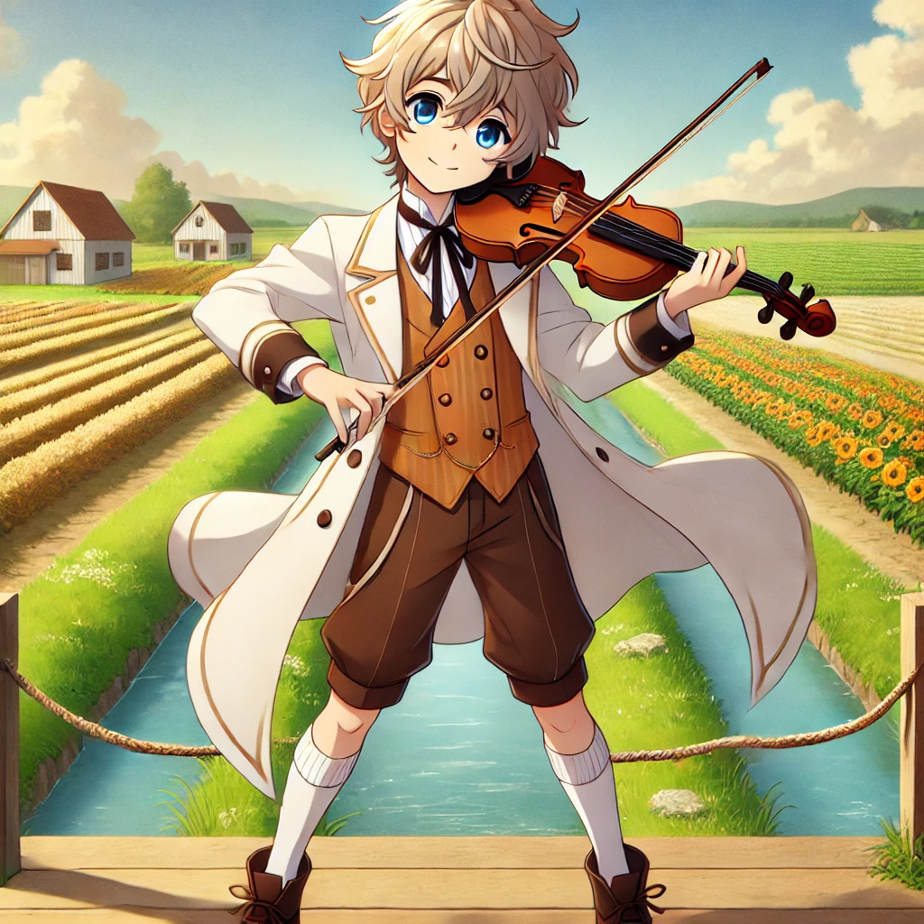
目標: 我是一名鄉村小孩，希望成為一位小提琴家，將我的音樂帶到全世界！
Notes:
A young character with short, tousled light blonde hair and bright blue eyes stands in a simple pose. He wears a white coat with brown accents over a white shirt and a black tie. The outfit includes brown shorts, white knee-high socks, and dark brown shoes. The overall look blends a playful style with a hint of formality, conveying a youthful yet polished appearance. 在農村中的舞台上表演小提琴(右手拉弓)，周圍有農地與水圳，很多農人微笑拍手。Emphasize it.

Slide 2
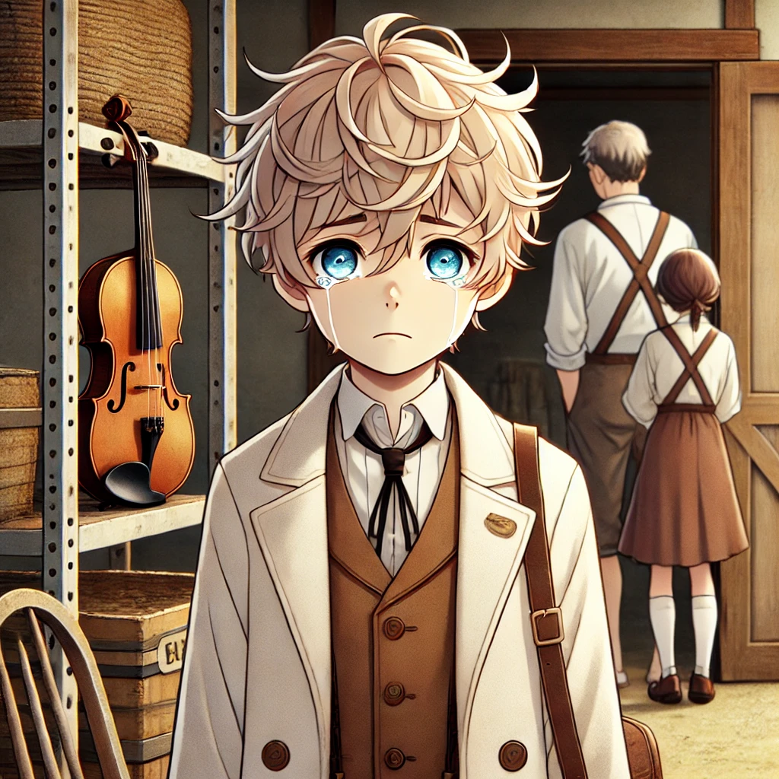
阻礙: 家人希望我繼承家業，成為一名農夫，而非追求音樂人的夢想。
Notes:
主角眼眶泛淚。主角父母在旁邊想像主角在農村耕種。身後有儲藏室的門(半開)，儲藏室內充滿灰塵，儲藏室中可以看到小提琴在的琴盒中，琴盒放在儲藏室裡。Emphasize it (日式風格). A young character with short, tousled light blonde hair and bright blue eyes stands in a simple pose. He wears a white coat with brown accents over a white shirt and a black tie. The outfit includes brown shorts, white knee-high socks, and dark brown shoes. The overall look blends a playful style with a hint of formality, conveying a youthful yet polished appearance.

Slide 3
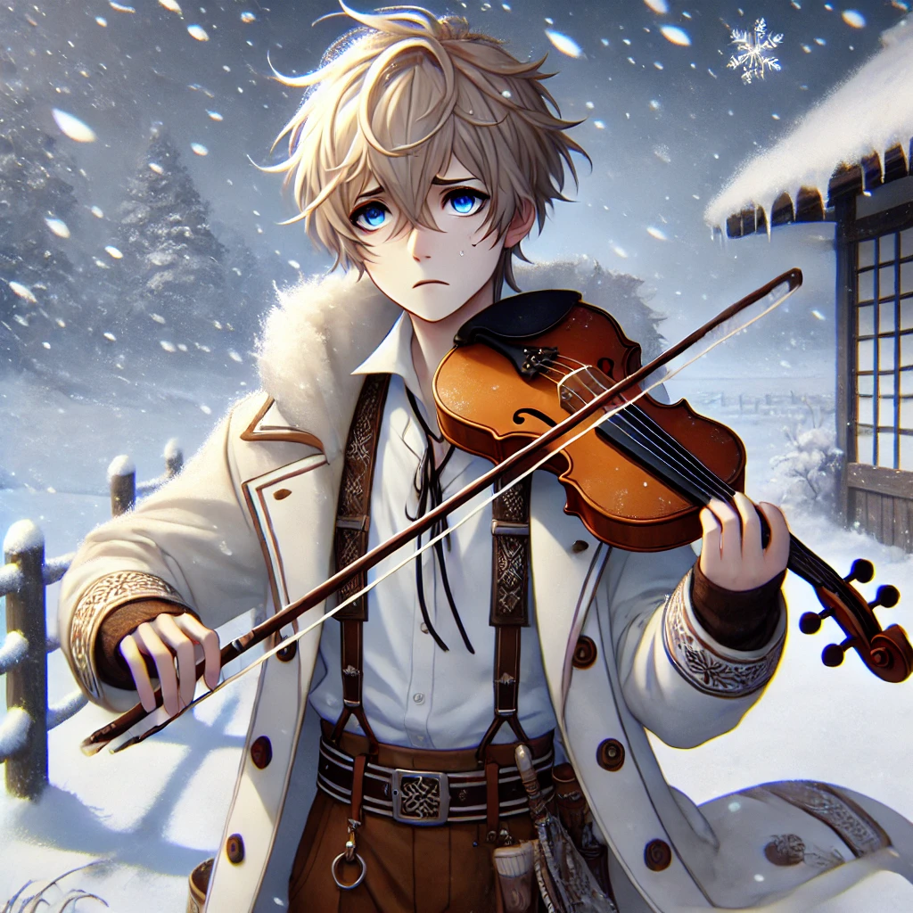
努力: 雖然得不到家人支持，我仍每天堅持練習小提琴，利用任何空閒時間磨練技藝並祕密存錢，希望有一天能踏上旅程。
Notes:
農村，酷寒飄雪。寒風中練習小提琴。寒冷顫抖。Emphasize it (日式畫風).
A young character with short, tousled light blonde hair and bright blue eyes stands in a simple pose. He wears a white coat with brown accents over a white shirt and a black tie. The outfit includes brown shorts, white knee-high socks, and dark brown shoes. The overall look blends a playful style with a hint of formality, conveying a youthful yet polished appearance.

Slide 4
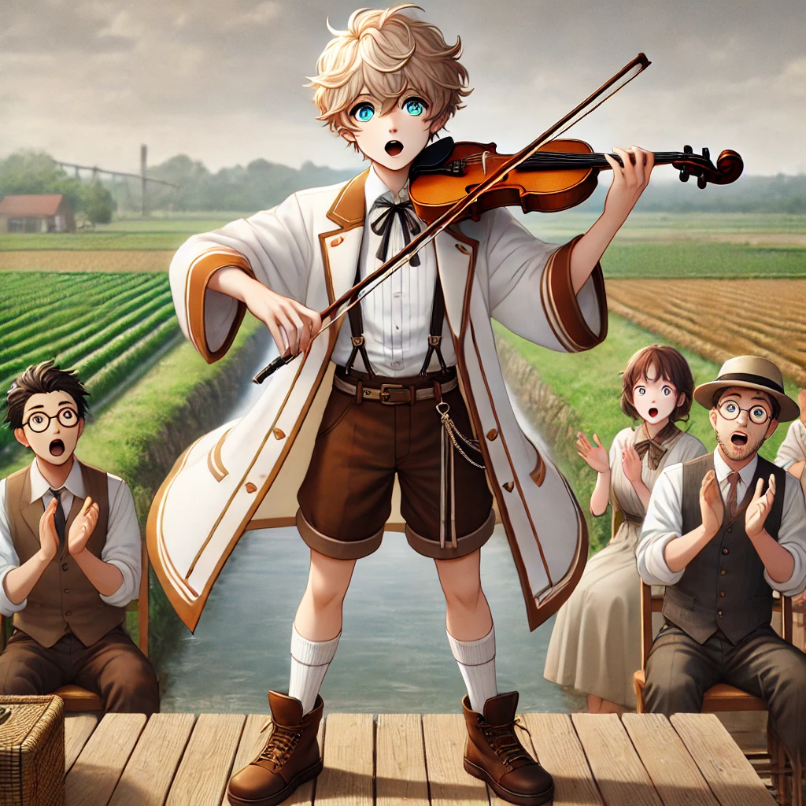
結果: 經過多年的努力，我獲得了一次在鎮上的音樂會演出的機會。我的表現表演讓眾人驚嘆，並吸引一位旅行音樂家的注意。 努力溝通下，家人總算同意我向其拜師學藝。
Notes:
A young character with short, tousled light blonde hair and bright blue eyes stands in a simple pose. He wears a white coat with brown accents over a white shirt and a black tie. The outfit includes brown shorts, white knee-high socks, and dark brown shoes. The overall look blends a playful style with a hint of formality, conveying a youthful yet polished appearance. 在農村中的舞台上表演小提琴(右手拉弓)，周圍有農地與水圳，家人驚訝拍手、喜悅的流淚。Emphasize it (日系畫風).

Slide 5
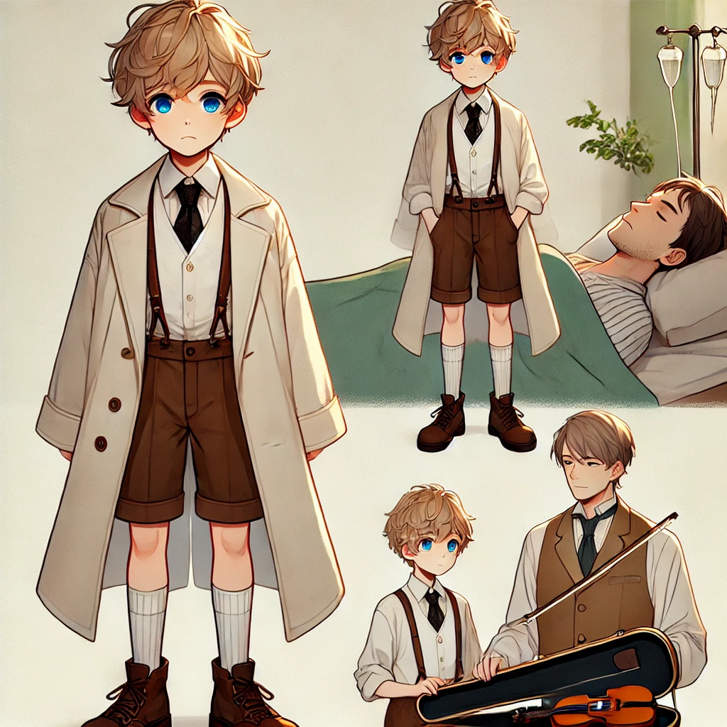
意外: 就在準備出發前夕，我父親突然重病，家裡陷入困進。我究竟該繼續追夢、還是留下來一起照顧父親？
Notes:
A young character with short, tousled light blonde hair and bright blue eyes stands in a simple pose. He wears a white coat with brown accents over a white shirt and a black tie. The outfit includes brown shorts, white knee-high socks, and dark brown shoes. The overall look blends a playful style with a hint of formality, conveying a youthful yet polished appearance. 左側父親重病臥床、右側我的小提琴琴盒在地上，右側還有另一明吟遊詩人打扮的男子。我在中間呈現焦急的樣子。Emphasize it (日系畫風).

Slide 6
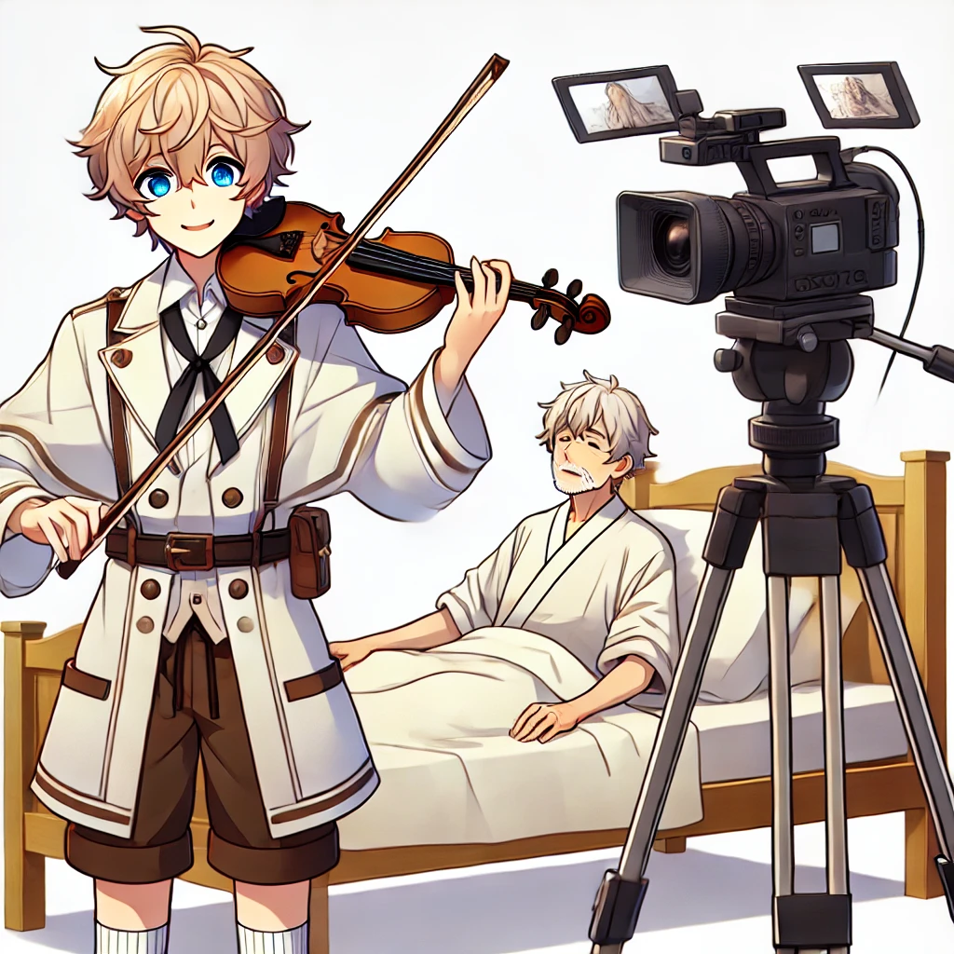
轉彎: 苦思良久，我終於下了艱難的決定——暫時放棄巡迴世界表演的夢想，來照顧父親。不過在那位音樂家的建議下，我的夢想暫時改變了形式，我決定改至YouTube上直播表演，希望能在網路上，巡迴世界演奏！
Notes:
A young character with short, tousled light blonde hair and bright blue eyes stands in a simple pose. He wears a white coat with brown accents over a white shirt and a black tie. The outfit includes brown shorts, white knee-high socks, and dark brown shoes. The overall look blends a playful style with a hint of formality, conveying a youthful yet polished appearance. 父親生病臥床，但是表情開心。旁邊我拉小提琴(右手持弓)。我跟父親之間，有專業錄影機(沒有攝影師)，架在腳架上向我錄影。畫面中「只有」出現一個我和一個父親，只有我們兩人。我的年齡約20歲。Emphasize it (日系畫風)

Slide 7
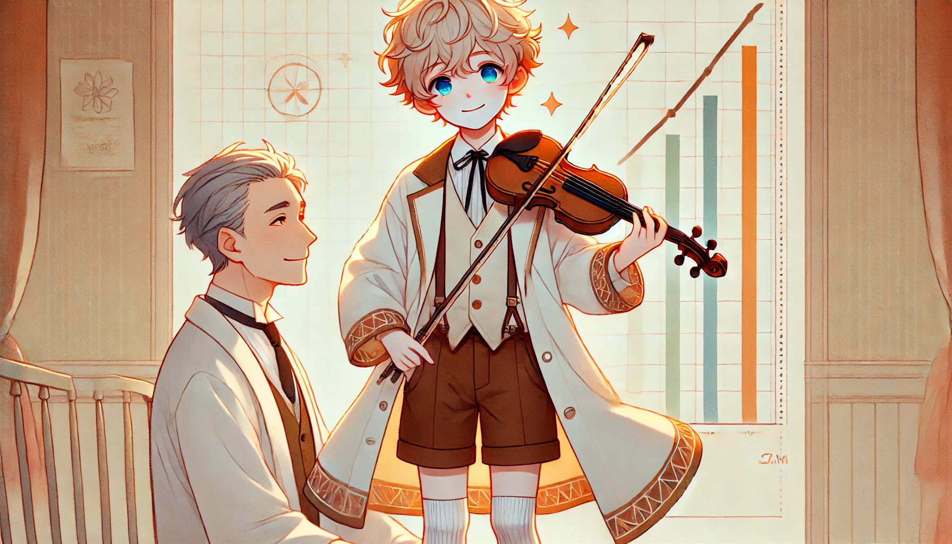
結局: 我透過YouTube直播演奏，雖然訂閱人數仍需繼續加油，但是頻道的經營也漸漸上了軌道。距離目標，還有長長的路要走，但一切都在順利前行中。父親的病情也日趨穩定，也許不久後，我將能重拾未竟的夢想！
Notes:
A young character with short, tousled light blonde hair and bright blue eyes stands in a simple pose. He wears a white coat with brown accents over a white shirt and a black tie. The outfit includes brown shorts, white knee-high socks, and dark brown shoes. The overall look blends a playful style with a hint of formality, conveying a youthful yet polished appearance. 我拉小提琴(右手持弓)、攝影機拍我。折線圖向上衝。父親可以下床了、開心、臉色紅潤。圖中只有兩個人: 我和我父親。Emphasize it (日系畫風)

